Slide 1
EU vs site OEE reports
Why Daily Losses, Plan OPT and Time Utilisation differ, and how to reconcile them
Hull and Nottingham | Power BI files compared up to 15 Sep 2026 | 27 Oct 2026

Slide 2
Same data, different set-up
Once the EU and site reports use the same machines and dates, the volumes match to within 0.05%
1. Hidden machine filter
2. Different glidepath files
3. Small formula effects
The EU queries drop machines the site reports keep: 19 at Hull, a different rule per table at Nottingham. This is the whole row and volume gap.
The EU reads targets from a regional folder, each site from its own. Hull's two files split in 2026; Nottingham's only differ in units.
The EU drops the seconds from Plan OPT times (about 0.1%) and each file was refreshed on a different day (under 0.01%).
40.2% → 0.02%
13.5% → 0.03%
6.5%
Hull Daily Losses duration gap, before / after the EU filter
Nottingham Daily Losses duration gap, before / after
Hull loss target (Value) gap that stays: glidepath, not filter
EU vs site OEE reports | data cut 15 Sep 2026
2

Slide 3
How we compared
Each check is repeated on the data extracted from the three .pbix files
1
2
3
4
Same cut
EU as shown
Site as-is
Site + EU rule
All visuals: date on or before 15 Sep 2026. The EU file ends on 16 Sep.
EU report table filtered to one site: what the EU pages show.
Site report table, no extra filter: what the site pages show.
Site table with the EU machine rule applied in the visual filter.
▪ Measured columns (stop count, Duration, Good Parts, Capacity, times) prove the filter.
▪ Looked-up columns (Value, targets) come from a glidepath file and are checked separately.
EU vs site OEE reports | data cut 15 Sep 2026
3

Slide 4
01
The hidden machine filter
A Power Query step in the EU report removes machines the site reports keep

Slide 5
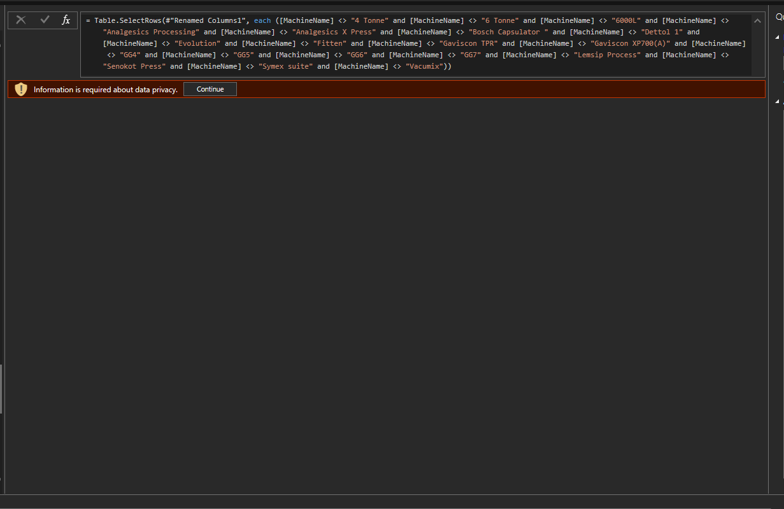
The EU report drops 19 Hull machines in Power Query
Step 'Filtered Rows' at the end of the Hull queries in the EU file; not visible on any page
Removed in all three Hull tables
4 Tonne, 6 Tonne, 6000L,
Analgesics Processing,
Analgesics X Press, Bosch Capsulator,
Dettol 1, Evolution, Fitten,
Gaviscon TPR, Gaviscon XP700(A),
GG4, GG5, GG6, GG7,
Lemsip Process, Senokot Press,
Symex suite, Vacumix
Mostly process equipment (mixers, presses, granulation). Same list in Daily Losses, Plan OPT and Time Utilisation.
EU vs site OEE reports | data cut 15 Sep 2026
5

Slide 6
Nottingham uses a different rule in each table
Plan OPT and Time Utilisation keep the same 23 packing machines; Daily Losses keeps manufacturing too
Table | Hull (EU rule) | Nottingham (EU rule) | Nottingham machines left
Daily Losses | remove 19 names | remove 9 names: Bosch, Fette 23, Fette12, Fette2, Fette20, Fette4, Fette5, Gran0, S14 | all others, manufacturing included
Plan OPT | remove 19 names | keep area ' Strepsils Packing' or 'SD Packing', remove S14 | 23 packing machines
Time Utilisation | remove 19 names | keep 23 named machines (N1, N3–N12, O5, O6, S04–S13, T2, T7) | the same 23
▪ Hull: one list, applied the same way in all three tables.
▪ Nottingham: three rules. Plan OPT and Time Utilisation end up with the same machines; Daily Losses does not. Note the leading space in ' Strepsils Packing'.
▪ Question for Reckitt: why is each rule there, and should Nottingham losses follow the packing-only rule of the other two tables?
EU vs site OEE reports | data cut 15 Sep 2026
6

Slide 7
02
Daily Losses
Stop count, Duration and loss target Value per month

Slide 8
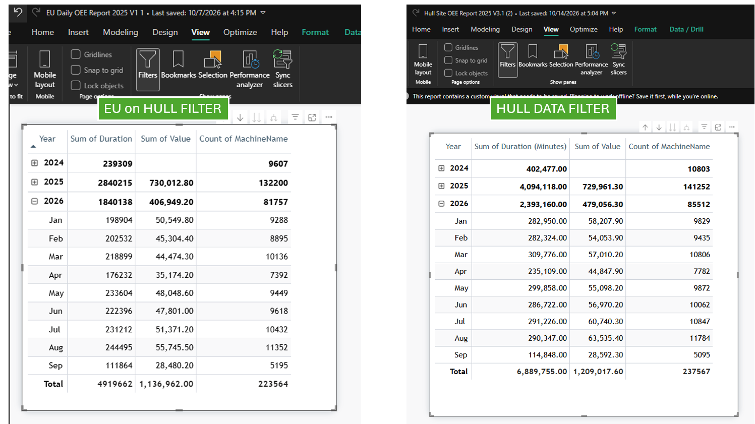
Hull Daily Losses: the gap before any filter
EU report (Hull) next to the Hull site report, as-is
GAP
Measure | EU | Site | Gap
Duration (min) | 4,919,662 | 6,897,737 | +40.21%
Stops | 223,564 | 237,930 | +6.43%
Value (target) | 1,136,962.0 | 1,211,173.4 | +6.53%
The site shows 14,366 more stops and 40% more duration than the EU for the same period.
EU vs site OEE reports | data cut 15 Sep 2026
8

Slide 9
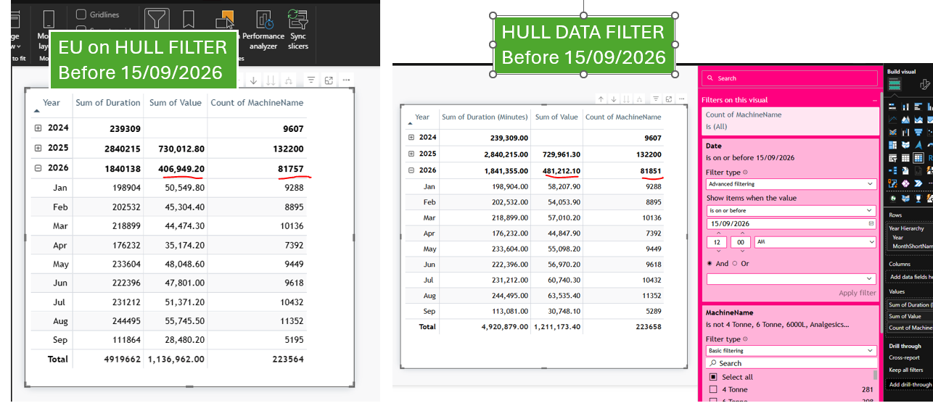
Hull Daily Losses: the EU filter closes the volume gap
Hull site report with the 19 machines removed in the visual filter
MATCH
Measure | EU | Site | Gap
Duration (min) | 4,919,662 | 4,920,879 | +0.02%
Stops | 223,564 | 223,658 | +0.04%
Value (target) | 1,136,962.0 | 1,211,173.4 | +6.53%
Duration and stops now match to 0.04%. Value stays 6.5% apart: it is a looked-up target, and the filter does not change which target a stop finds (section 05).
EU vs site OEE reports | data cut 15 Sep 2026
9

Slide 10
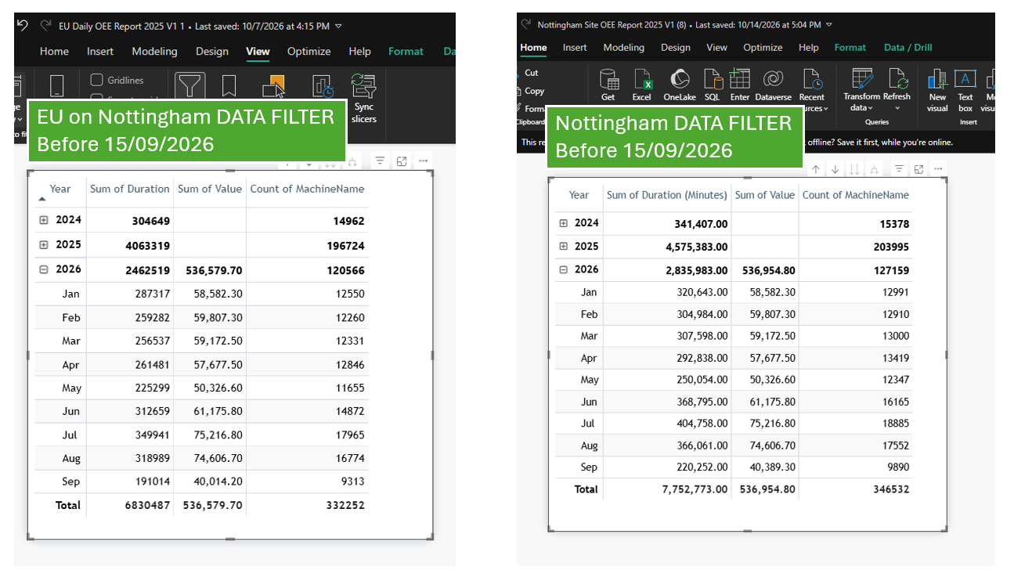
Nottingham Daily Losses: the gap before any filter
EU report (Nottingham) next to the Nottingham site report, as-is
GAP
Measure | EU | Site | Gap
Duration (min) | 6,830,487 | 7,752,773 | +13.50%
Stops | 332,252 | 346,532 | +4.30%
Value (target) | 536,579.7 | 536,954.8 | +0.07%
13.5% more duration and 14,280 more stops on the site. Value already matches.
EU vs site OEE reports | data cut 15 Sep 2026
10

Slide 11
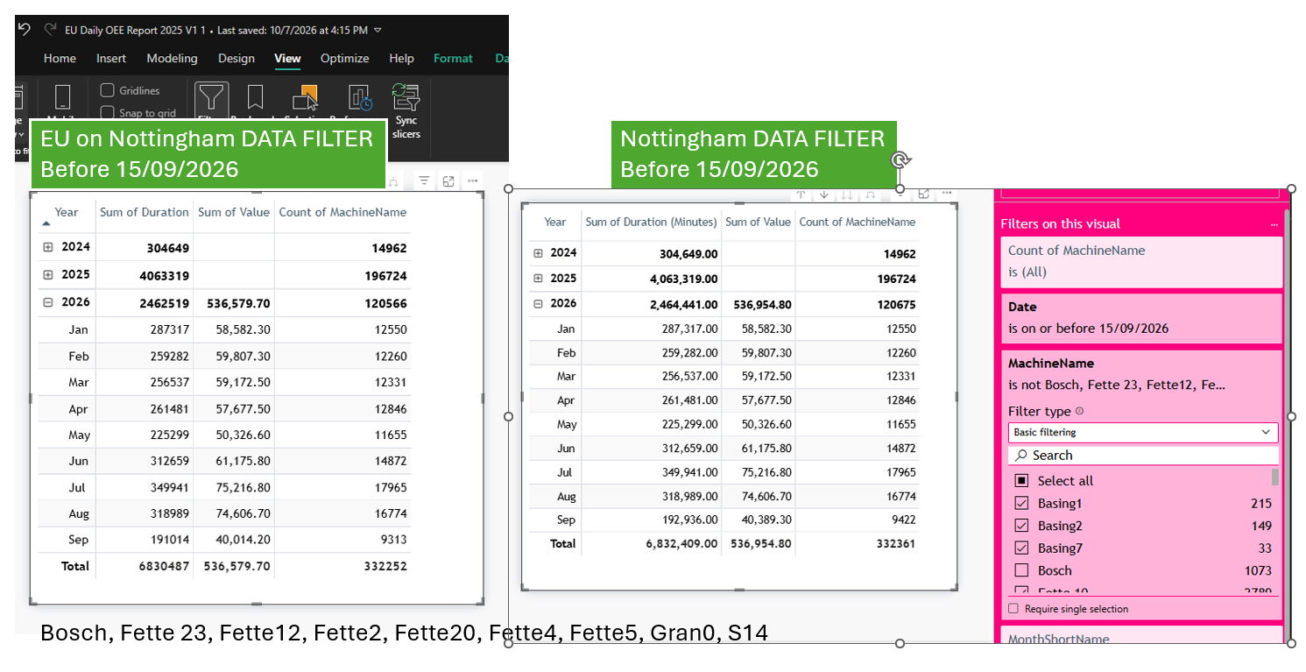
Nottingham Daily Losses: the 9-machine rule closes the gap
Nottingham site report without Bosch, Fette 23, Fette12, Fette2, Fette20, Fette4, Fette5, Gran0, S14
MATCH
Measure | EU | Site | Gap
Duration (min) | 6,830,487 | 6,832,409 | +0.03%
Stops | 332,252 | 332,361 | +0.03%
Value (target) | 536,579.7 | 536,954.8 | +0.07%
All three measures within 0.07%. Take care with near-identical names: excluding 'Fette 10' by mistake flips the gap to –4%.
EU vs site OEE reports | data cut 15 Sep 2026
11

Slide 12
Daily Losses: gap to the EU, before and after the filter
Grand totals, Dec 2024 to 15 Sep 2026 (notebook compare_eu_vs_site.ipynb)
 | Before | After
Hull Duration | +40.21% | +0.02%
Hull Stops | +6.43% | +0.04%
Hull Value | +6.53% | +6.53%
Notts Duration | +13.50% | +0.03%
Notts Stops | +4.30% | +0.03%
Notts Value | +0.07% | +0.07%
Left after the filter: only Hull Value (glidepath) and a few stops of the last days (refresh date).
EU vs site OEE reports | data cut 15 Sep 2026
12

Slide 13
03
Plan OPT
Good Parts, Capacity and the three times per month

Slide 14
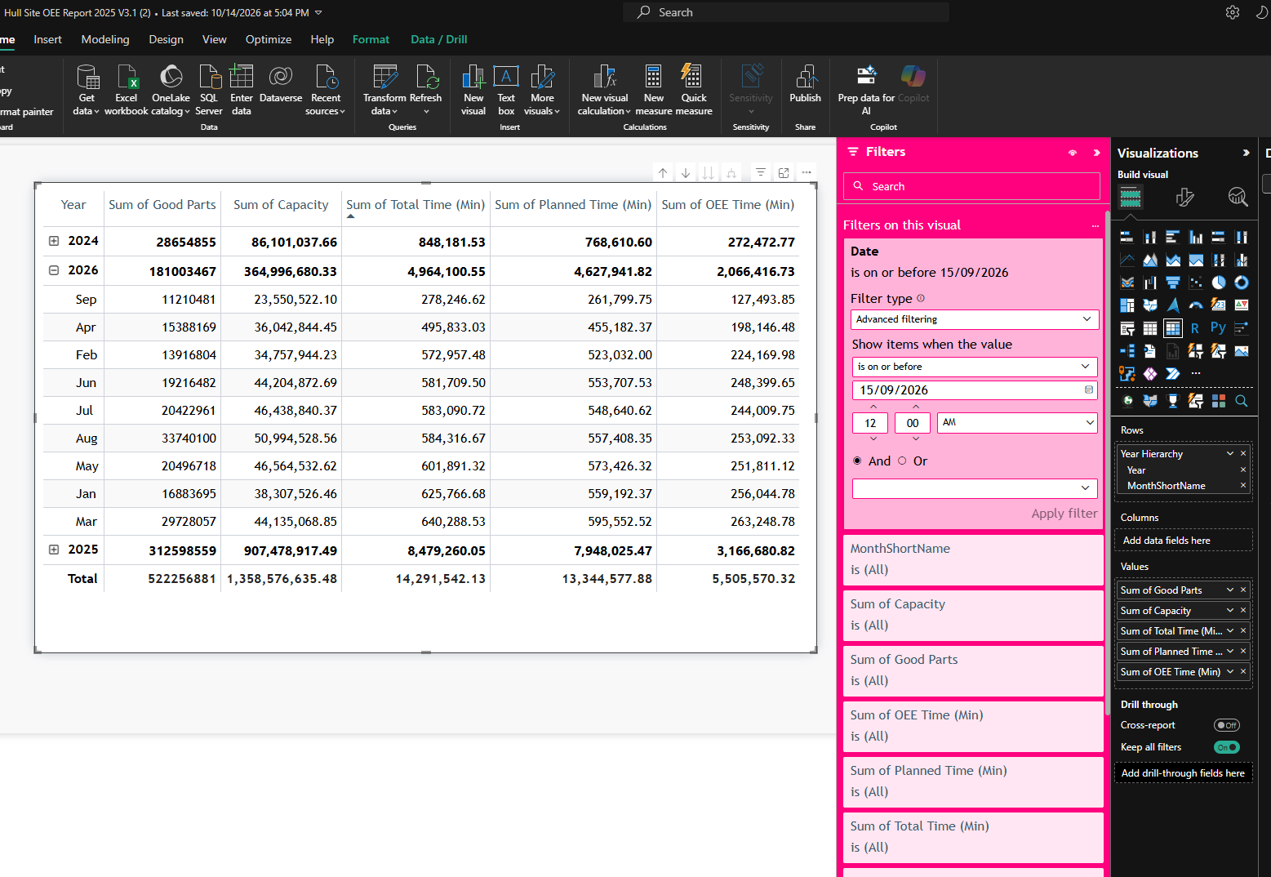
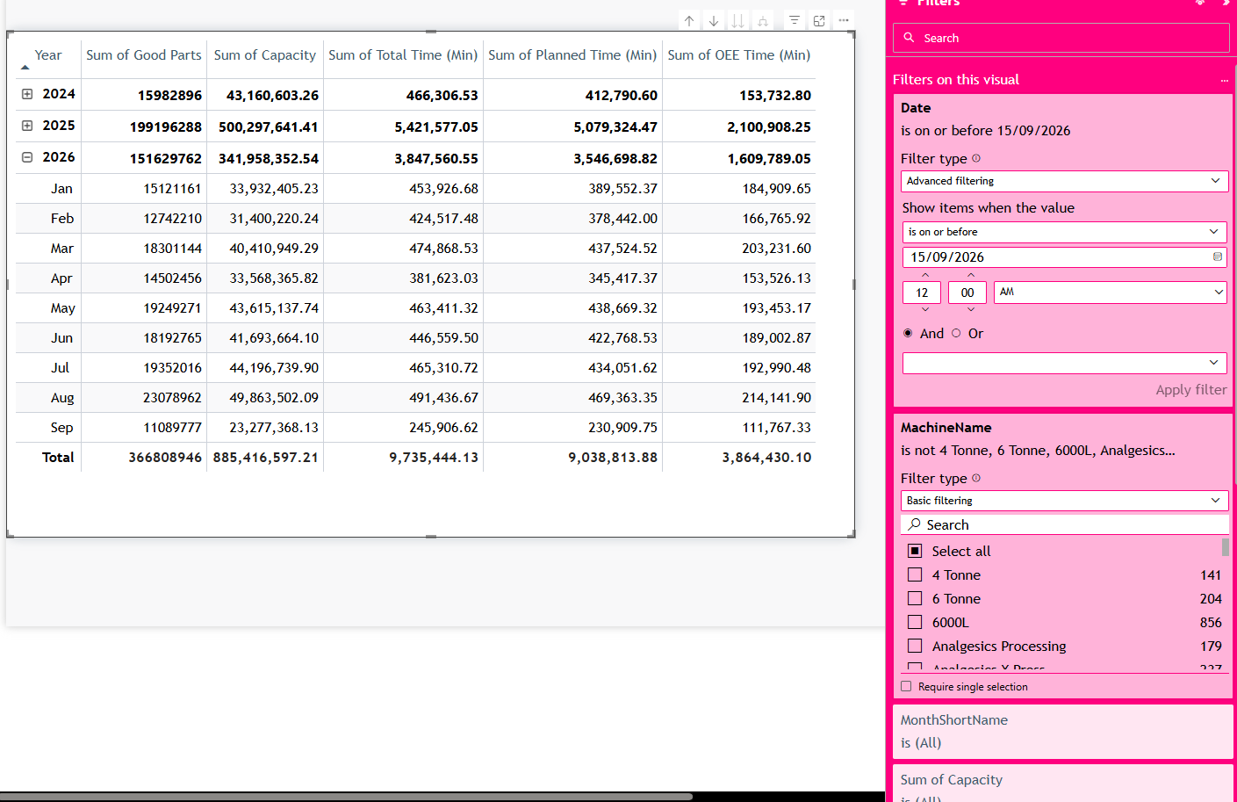
Hull Plan OPT: site before and after the EU filter
Hull site report, date on or before 15 Sep 2026
Site as-is
Site + 19 machines removed
EU vs site OEE reports | data cut 15 Sep 2026
14

Slide 15
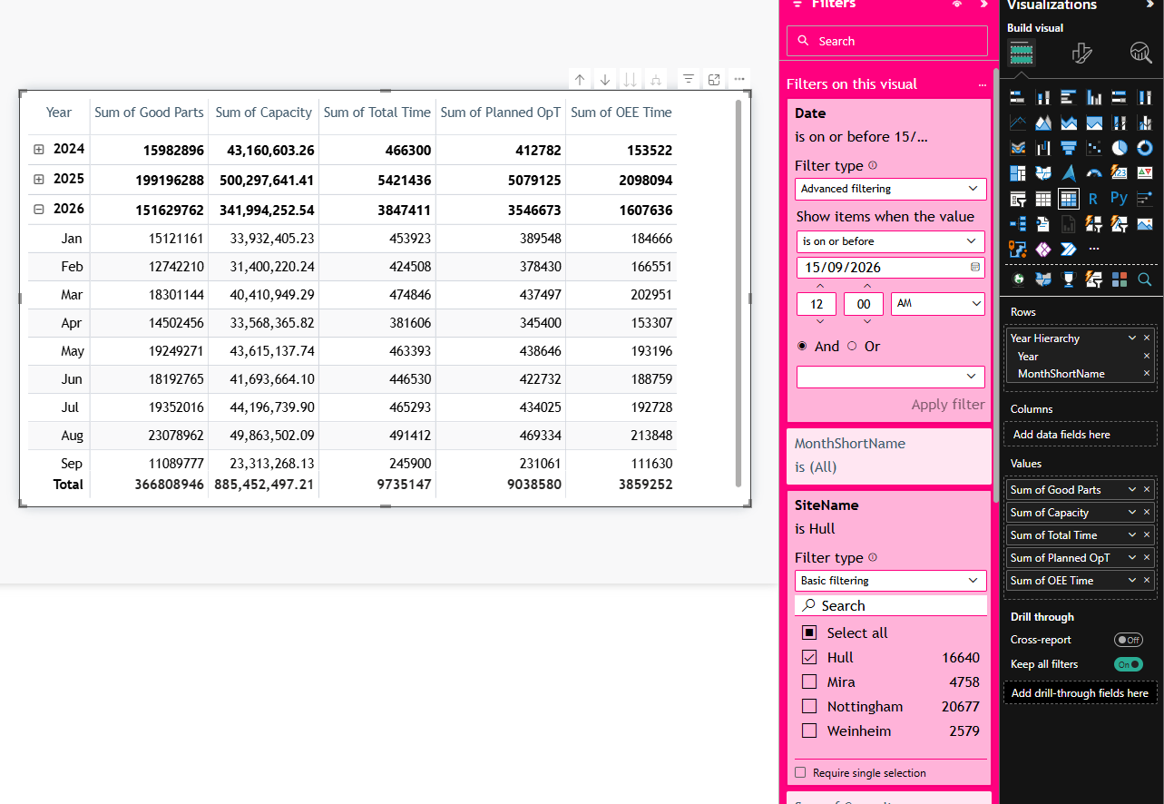
Hull Plan OPT: the EU view matches the filtered site
EU report, Plan OPT EU, site = Hull
MATCH
Measure | Site + filter | EU | Gap
Good Parts | 366,808,946 | 366,808,946 | +0.00%
Capacity | 885,416,597 | 885,452,497 | -0.00%
Total Time (min) | 9,735,444 | 9,735,147 | +0.00%
Planned Time (min) | 9,038,814 | 9,038,580 | +0.00%
OEE Time (min) | 3,864,430 | 3,859,252 | +0.13%
Counts identical. The EU times are whole minutes: its union step keeps hours × 60 + minutes and drops the seconds, so OEE Time is 0.13% lower.
EU vs site OEE reports | data cut 15 Sep 2026
15

Slide 16
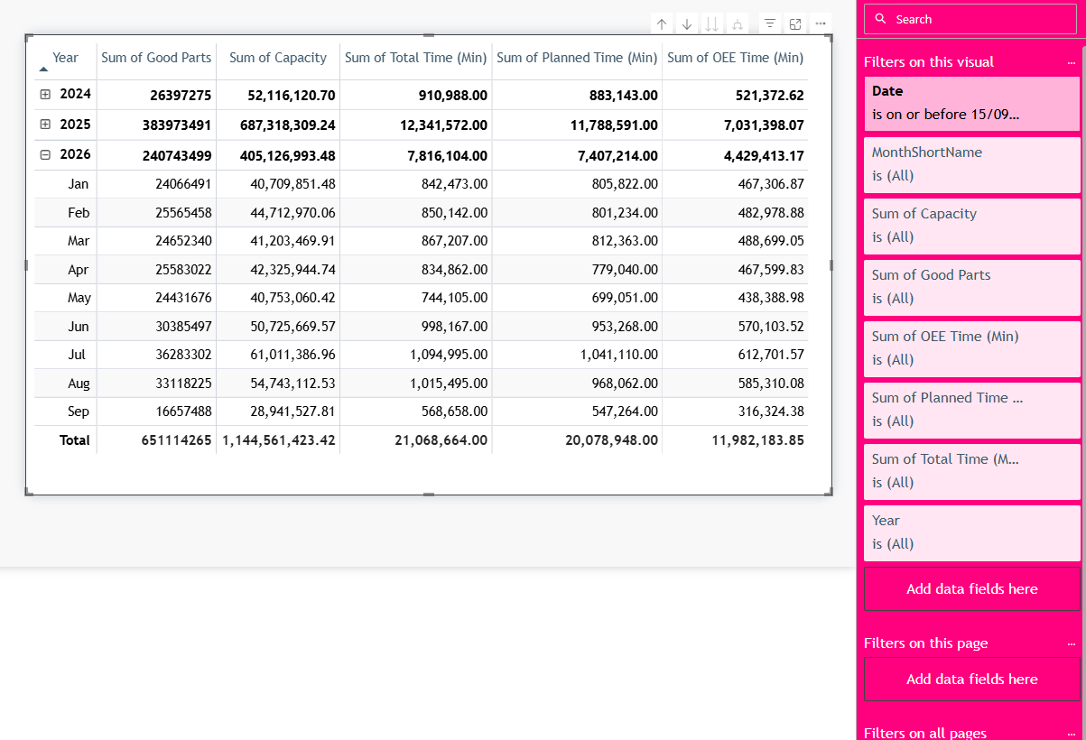
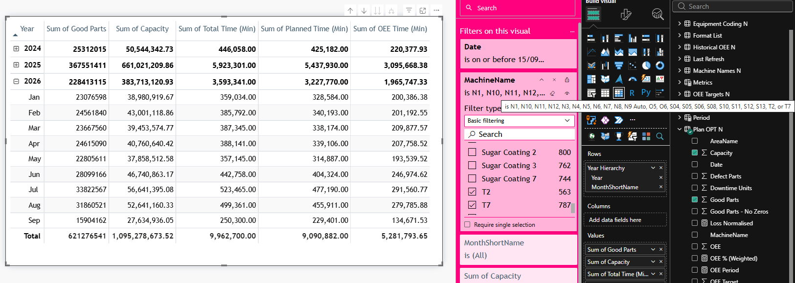
Nottingham Plan OPT: site before and after the EU rule
Nottingham site report, 23 packing machines kept
Site as-is
Site + 23 packing machines
EU vs site OEE reports | data cut 15 Sep 2026
16

Slide 17
Plan OPT: gap to the EU, both sites
EU Nottingham values from the data loaded in the EU .pbix
Site / measure | Site as-is | Site + EU rule | EU | Gap as-is | Gap after
Hull Good Parts | 522,256,881 | 366,808,946 | 366,808,946 | +42.38% | +0.00%
Hull Capacity | 1,358,576,635 | 885,416,597 | 885,452,497 | +53.43% | -0.00%
Hull OEE Time (min) | 5,505,570 | 3,864,430 | 3,859,252 | +42.66% | +0.13%
Nottingham Good Parts | 651,114,265 | 621,276,541 | 621,276,541 | +4.80% | +0.00%
Nottingham Capacity | 1,144,561,423 | 1,095,278,674 | 1,095,225,034 | +4.50% | +0.00%
Nottingham OEE Time (min) | 11,982,184 | 5,281,794 | 5,276,230 | +127.10% | +0.11%
▪ Good Parts: identical at both sites once the EU rule is applied.
▪ Capacity: 0.004 to 0.005% apart, from the refresh date.
▪ OEE Time: 0.1% lower in the EU: seconds dropped in the union step, a formula difference.
EU vs site OEE reports | data cut 15 Sep 2026
17

Slide 18
04
Time Utilisation
OEE Time, Total Time and Planned OPT per month

Slide 19
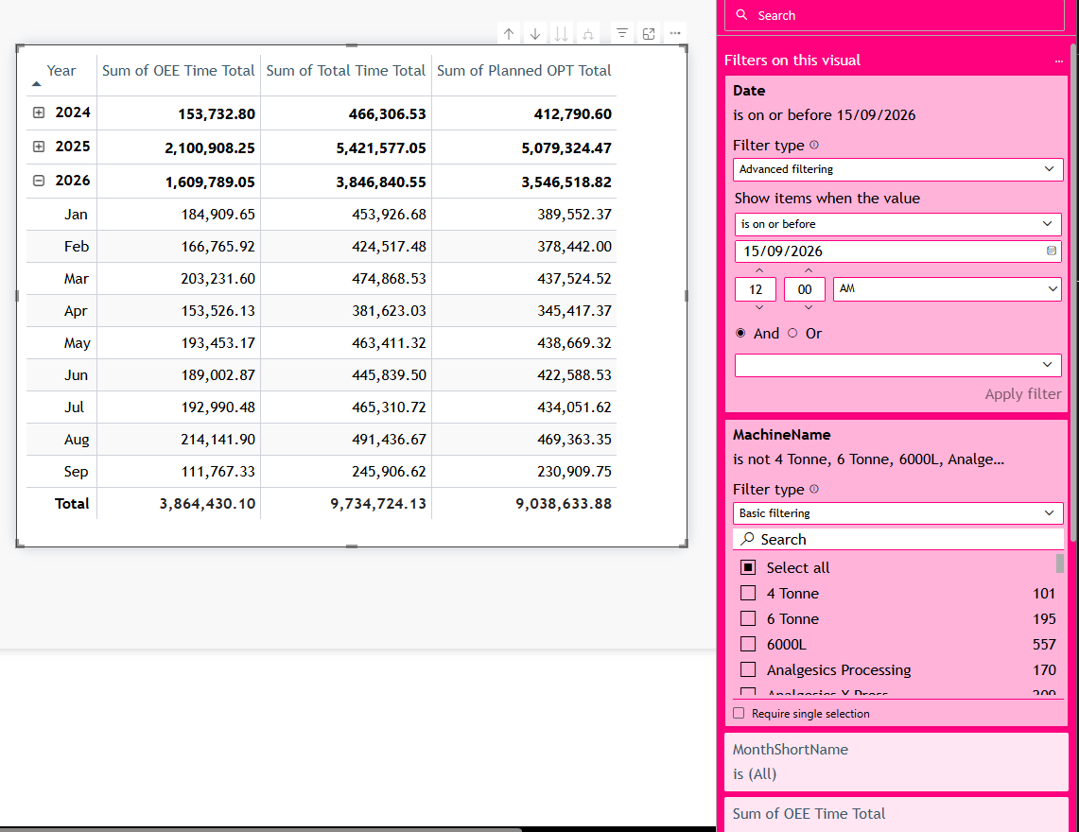
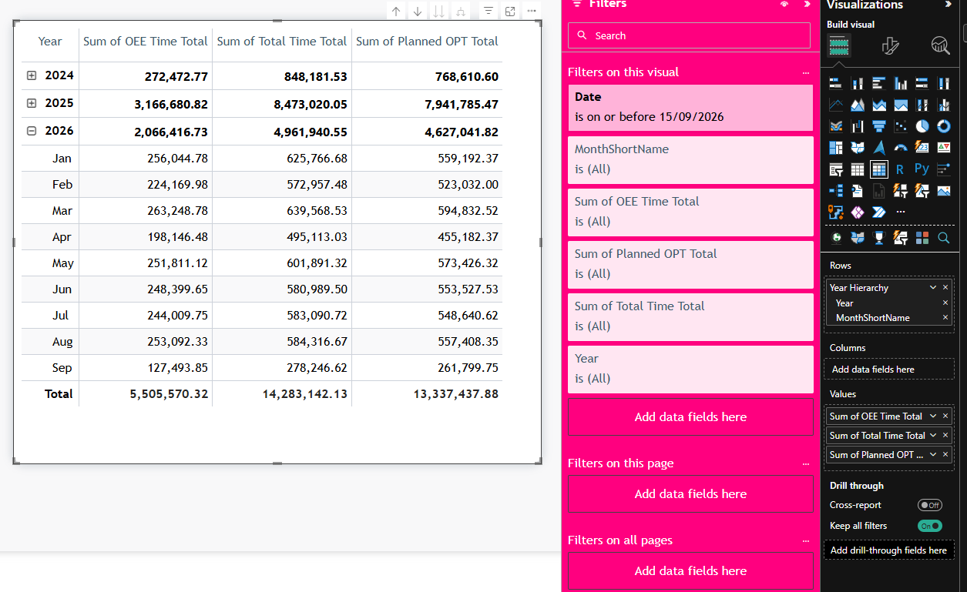
Hull Time Utilisation: site before and after the EU filter
Hull site report, date on or before 15 Sep 2026
Site as-is
Site + 19 machines removed
EU vs site OEE reports | data cut 15 Sep 2026
19

Slide 20
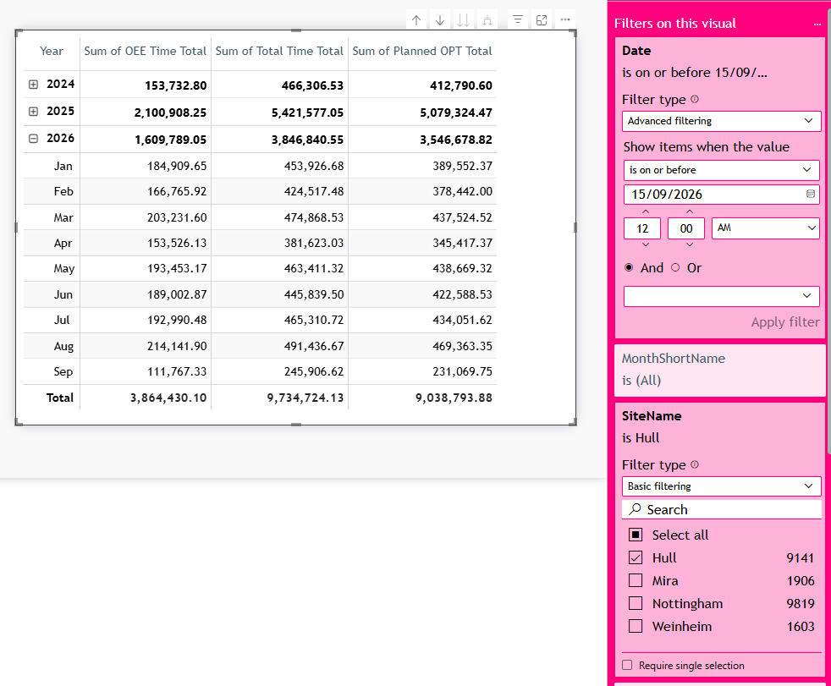
Hull Time Utilisation: the EU view matches to the decimal
EU report, Time Utilisation EU, site = Hull
MATCH
Measure | Site + filter | EU | Gap
OEE Time Total | 3,864,430.10 | 3,864,430.10 | +0.00%
Total Time Total | 9,734,724.13 | 9,734,724.13 | +0.00%
Planned OPT Total | 9,038,633.88 | 9,038,793.88 | -0.00%
Time Utilisation keeps the seconds in both reports, so the times match exactly. The 160 minutes on Planned OPT are the refresh date.
EU vs site OEE reports | data cut 15 Sep 2026
20

Slide 21
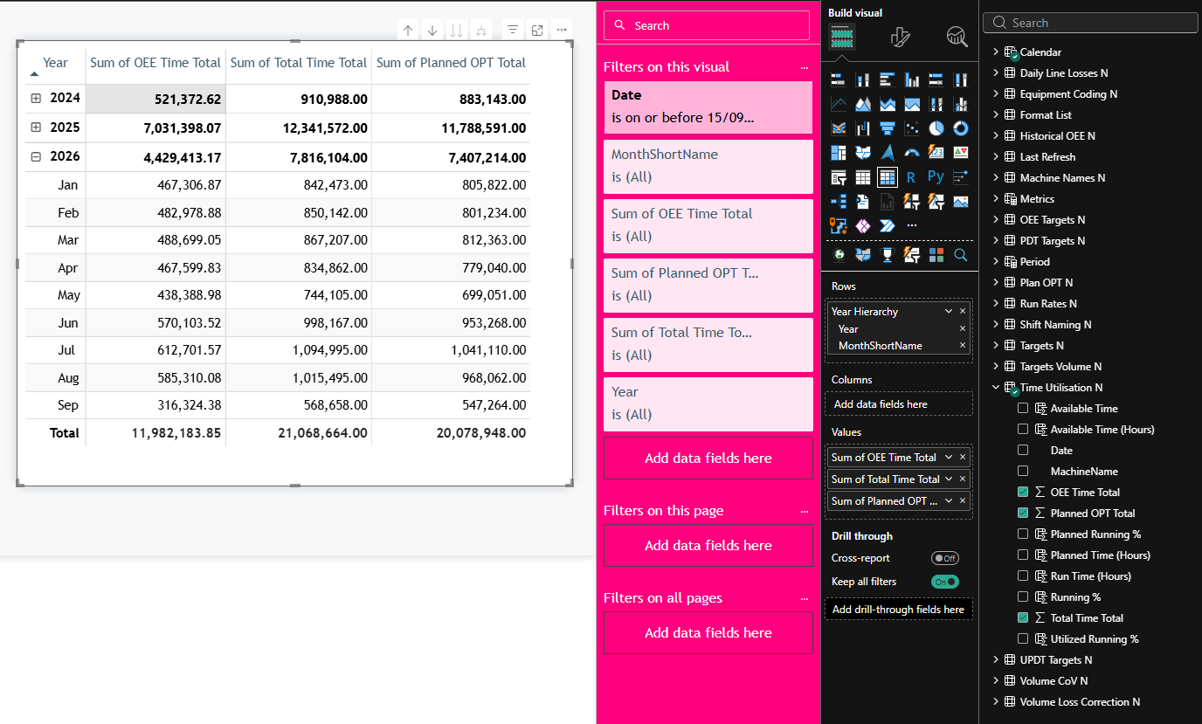
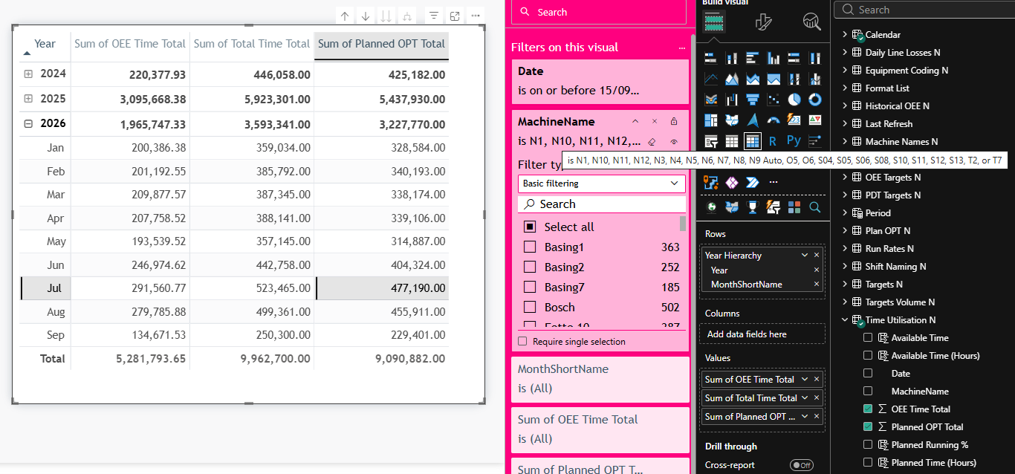
Notts Time Utilisation: site before and after the EU rule
Nottingham site report, 23 packing machines kept
Site as-is
Site + 23 packing machines
EU vs site OEE reports | data cut 15 Sep 2026
21

Slide 22
Time Utilisation: gap to the EU, both sites
EU Nottingham values from the data loaded in the EU .pbix
Site / measure | Site as-is | Site + EU rule | EU | Gap as-is | Gap after
Hull OEE Time | 5,505,570 | 3,864,430 | 3,864,430 | +42.47% | +0.00%
Hull Total Time | 14,283,142 | 9,734,724 | 9,734,724 | +46.72% | +0.00%
Hull Planned OPT | 13,337,438 | 9,038,634 | 9,038,794 | +47.56% | -0.00%
Nottingham OEE Time | 11,982,184 | 5,281,794 | 5,282,268 | +126.84% | -0.01%
Nottingham Total Time | 21,068,664 | 9,962,700 | 9,962,700 | +111.48% | +0.00%
Nottingham Planned OPT | 20,078,948 | 9,090,882 | 9,091,122 | +120.86% | -0.00%
▪ Before: the site shows 42% (Hull) to 127% (Nottingham) more OEE Time than the EU.
▪ After: every measure within 0.01%. The machine rule is the whole difference.
EU vs site OEE reports | data cut 15 Sep 2026
22

Slide 23
05
Glidepath targets
The loss target (Value) and the OEE targets come from three different files

Slide 24
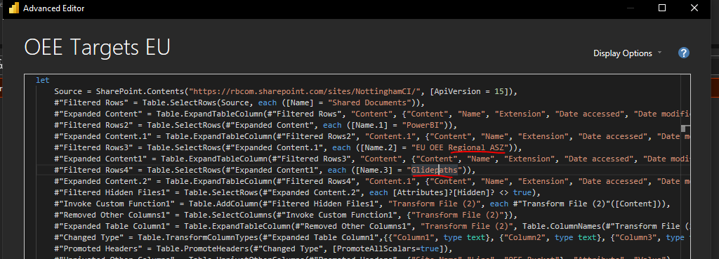
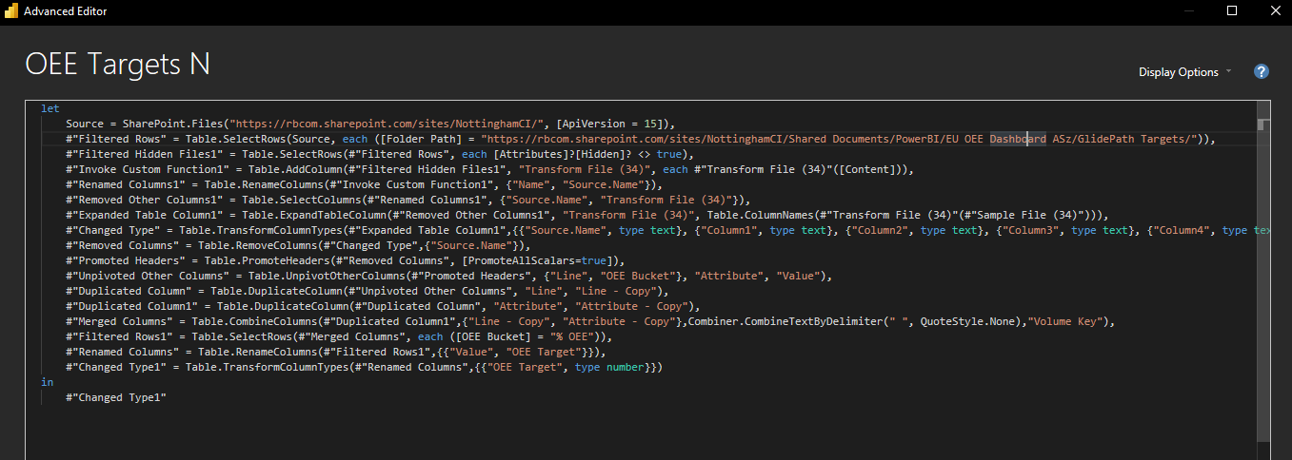
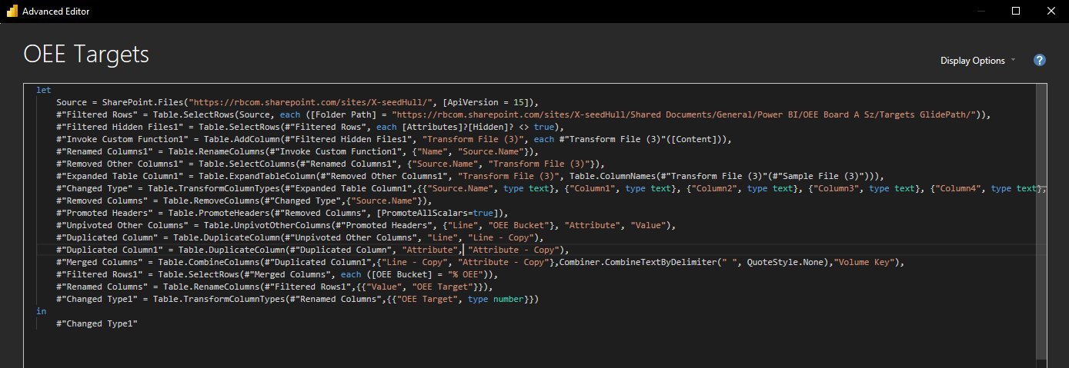
Three reports, three glidepath folders
Power Query source step of the target query in each .pbix
EU report: EU OEE Regional ASZ / Glidepaths
Nottingham site: EU OEE Dashboard ASz / GlidePath Targets
Hull site: X-seedHull / Targets GlidePath
A site that updates its own glidepath does not change the EU report. Someone has to copy the change into the regional folder too.
EU vs site OEE reports | data cut 15 Sep 2026
24

Slide 25
Glidepath files compared cell by cell
Same line, OEE bucket and month; Hull bucket names mapped to the EU names (compare_glidepaths.ipynb)
 | Same | Diff. | Only reg. | Only site
Hull 2025 | 5,148 | 0 | 0 | 0
Hull 2026 | 3,807 | 818 | 204 | 475
Notts 2025 | 0 | 0 | 24 | 0
Notts 2026 | 4,152 | 540 | 0 | 0
Hull 2025: identical. Hull 2026: the files split. Nottingham: same targets.
EU vs site OEE reports | data cut 15 Sep 2026
25

Slide 26
What differs in the glidepath files
Hull: different 2026 targets. Nottingham: same targets, different unit
Hull 2026
Nottingham
▪ 818 targets differ, not by one factor. T1 % OEE Jan 2026: regional 44.7, site 47.7.
▪ SP1 and SP2 have targets only in the site file; they ran 5,094 and 2,135 stops in 2026.
▪ Saloon has targets only in the regional file (225 stops, last 27 Mar 2026).
▪ Bucket names differ too: site 'Lack of Resource', regional 'Lack Of Resources'.
▪ All loss buckets and % OEE match.
▪ Two totals differ by exactly 100×: Unplanned and Planned Downtime (Total). Site holds 0.147, regional 14.7.
▪ Effect: Nottingham Value matches; UPDT and PDT targets look 100 times apart.
EU vs site OEE reports | data cut 15 Sep 2026
26

Slide 27
Hull Value: the glidepath is the whole remaining gap
Cause by cause, from the EU table to the Hull site table (proof-eu-site-config-daily-losses.ipynb)
 | Value
EU (Hull) | 1,136,962.0
+ glidepath file and key | +73,847.0
+ refresh date | –237.7
= Hull site | 1,210,571.3
Redoing the EU lookup with the site's file and key reproduces the site Value on all but 36 of 224,885 stops.
EU vs site OEE reports | data cut 15 Sep 2026
27

Slide 28
06
Summary and reconciliation
What differs, how big it is, and the options

Slide 29
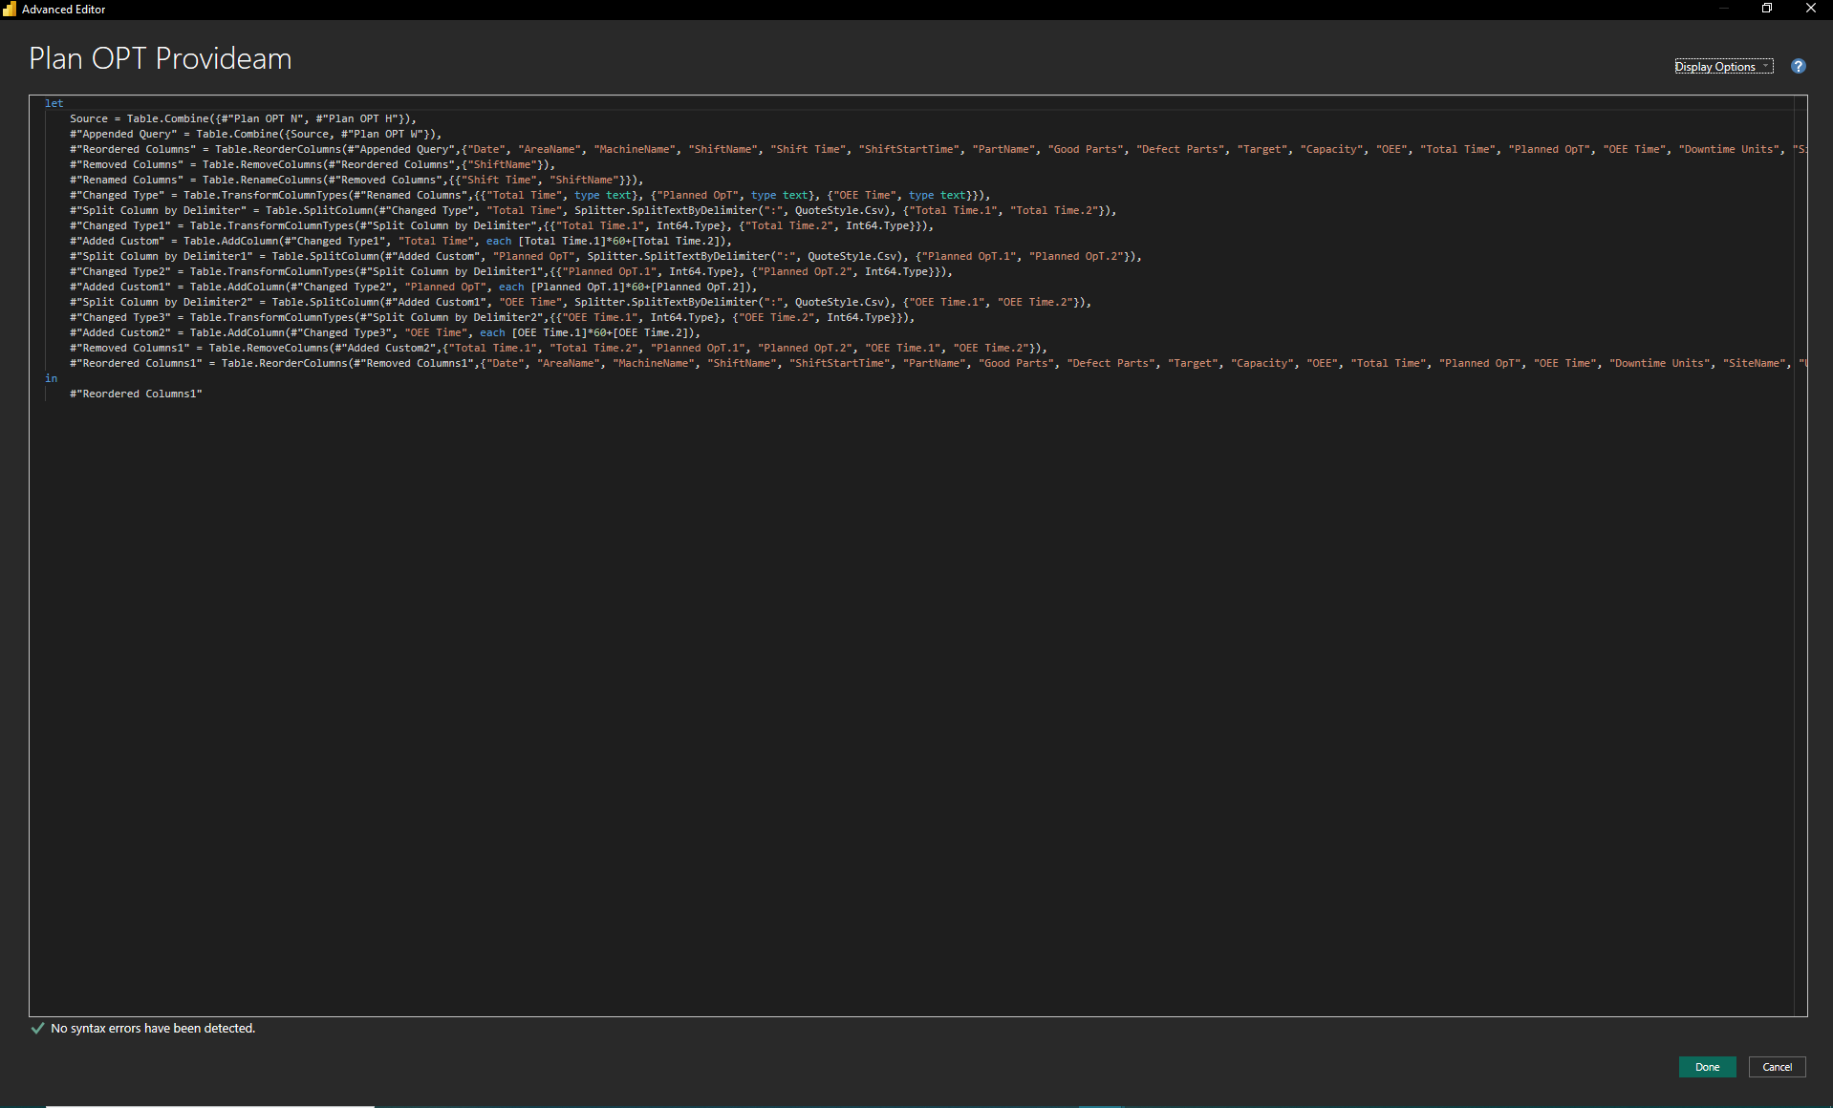
Smaller differences to know
None of these changes the conclusion, but each shows up in a detailed check
▪ Seconds dropped: the EU Plan OPT union splits each time on ':' and keeps hours and minutes (OEE Time –0.1%).
▪ Hull duplicates: the site keeps the newest copy of a stop found in two files, the EU the first listed.
▪ Nottingham machine names: 2,651 EU stops (Sep) have no row in Machine Names EU and drop out of visuals split by area or machine.
▪ Volume Total: repeated on every stop of a machine and day; never sum it.
▪ Not checked: slicers and page filters, Weinheim and Mira.
EU vs site OEE reports | data cut 15 Sep 2026
29

Slide 30
What makes the EU and site numbers differ
Size of each cause at Hull and Nottingham, data up to 15 Sep 2026
Cause | Tables | Hull | Nottingham | Kind
Hidden machine filter | all three | Losses +40% min, Plan OPT +42% Good Parts | Losses +13.5% min, TU +127% OEE Time | scope rule
Glidepath file and key | Losses Value, targets | Value +6.5% | units of 2 totals (100×) | reference data
Seconds dropped | Plan OPT times | OEE Time –0.13% | OEE Time –0.1% | formula
Refresh date | all | under 0.01% | under 0.01% | timing
With the same scope and the same target file, the EU and site reports give the same numbers.
EU vs site OEE reports | data cut 15 Sep 2026
30

Slide 31
Reconciliation options: machine scope
Decide one rule per site and apply it once
Option 1
Option 2
Use the site data as it is
One shared 'In EU Report' rule
▪ No extra filter: EU = site.
▪ EU totals go up (process machines added).
▪ Simple, nothing to maintain.
▪ One lookup per site and machine decides what the EU counts.
▪ Same rule for all three tables.
▪ Already built in the new report tables (config/report_scope.csv).
Questions for Reckitt
Why are these machines out of the EU report (packing lines only?) • Why does Nottingham Daily Losses keep manufacturing machines when Plan OPT and Time Utilisation do not?
EU vs site OEE reports | data cut 15 Sep 2026
31

Slide 32
Reconciliation options: glidepath
One master file per site, one unit, one set of bucket names
Hull
Nottingham
Process
▪ Pick the master: regional or the site's V7 file.
▪ The site file covers SP1, SP2 and the 2026 revisions; the regional copy looks like 2025.
▪ Align bucket names with the EU names, or the lookup misses.
▪ Content already the same.
▪ Agree one unit for the two Downtime totals: percent or fraction.
▪ Then the regional and site files can be one file.
▪ Who updates the regional folder when a site changes its glidepath?
▪ How often do the targets change (monthly, yearly)?
▪ One file read by every report removes this gap for good.
EU vs site OEE reports | data cut 15 Sep 2026
32

Slide 33
Next steps
1
Reckitt confirms the machine scope rule per site and table
2
Reckitt names the master glidepath file per site and the unit of the totals
3
Apply both in one place: the scope file and one glidepath per site
4
Re-run the same checks (EU vs site, Duration, Good Parts, Value) after the change

